Slide 1
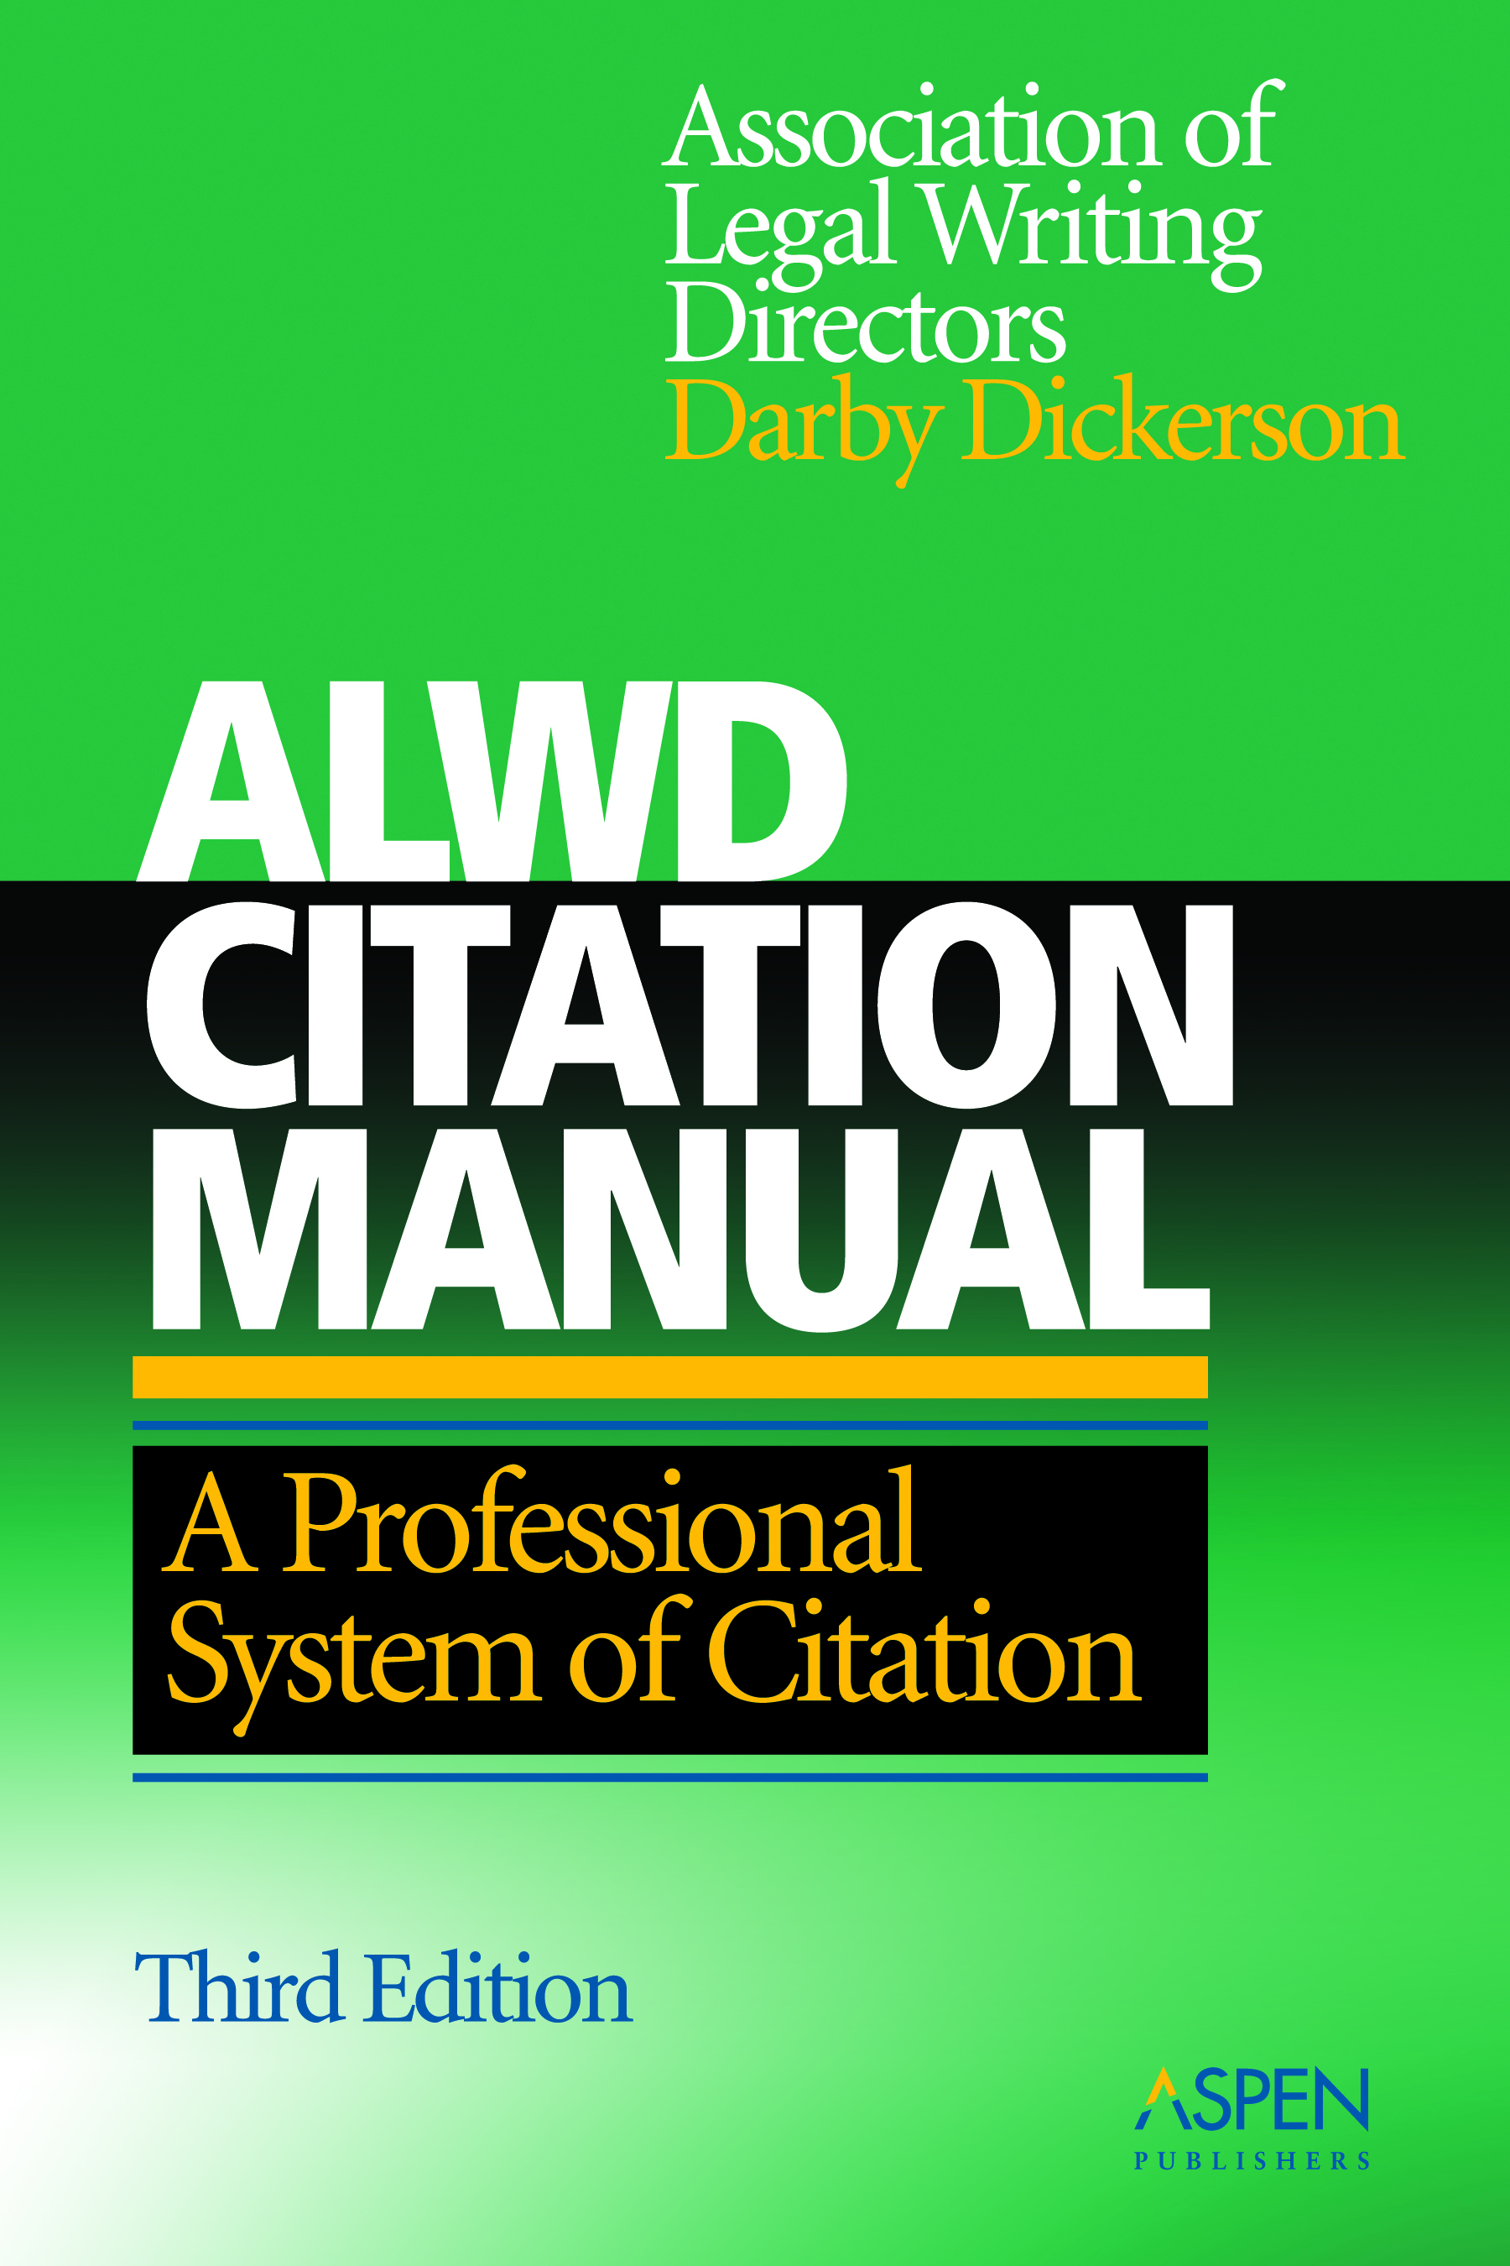
ALWD Citation
Manual
A Professional System of
Citation (Third Edition)

Slide 2
Background
Origins trace to January 1997
  AALS resolution regarding the Bluebook
Development included:
  review of citation practices and manuals
  review of research manuals
  review of actual documents
  review by professors at many different schools
  review by librarians and reporters of decisions
  user input

Slide 3
Philosophy
“Restatement of citation”
  With changes when necessary to enhance consistency and ease of usage
  Not “change for the sake of change”
Teaching and learning tool
  Dual colors
  Visual aids
  Sidebars – “tips for the unwary”
  More examples, labeled examples
  Assistance through Web and e-mail
One citation system, not two

Slide 4
Adoptions
Professors at over 90 schools:
  American University
  Boston University
  Northwestern University
  University of Michigan
  University of California -- Hastings
  University of Colorado
  University of Oregon
  University of Texas
  Wake Forest

Slide 5
Adoptions
Approximately 50 paralegal programs
About two dozen law journals
U.S. District Court of the District of Montana
  In lieu of the Bluebook
Given equal treatment in Bryan Garner’s Redbook (new book on legal style)
Use by judicial law clerks

Slide 6
States that Require Bluebook Format in Court Documents
California
Delaware
Indiana
Kansas
North Carolina
North Carolina
South Carolina
Texas
Washington State
Wisconsin
Local citation rules

Slide 7
ALWD v. Bluebook
Ease of use/learning
One citation system
Differences are relatively minor, especially for memos and briefs
Significant difference in law review format is the elimination of large and small caps
  Handout – typeface, periodicals, books
  Powerpoint presentation
  Easy to convert

Slide 8
Case Citations
Memos and Briefs
  Burlington Indus., Inc. v. Ellerth, 524 U.S. 742 (1998).
  Dart Indus., Inc. v. Liberty Mut. Ins. Co., 484 F.2d 1295 (9th Cir. 1973).
Law Review
  BB: Sanborn v. Wagner, 354 F. Supp. 291 (D. Md. 1973).
  ALWD: Sanborn v. Wagner, 354 F. Supp. 291 (D. Md. 1973).

Slide 9
State Format – Cases
BB and ALWD: Smith v. Jones, 650 So. 2d 500 (La. 1994).
Louisiana: Smith v. Jones, 93-2345 (La. 7/15/94), 650 So.2d 500.

Slide 10
Statutes
Memos and Briefs
  42 U.S.C. § 3612(g)(5)(B) (2000).
  Or. Rev. Stat. Ann. § 60.357(5) (1995).
Law Review
  BB: OR. REV. STAT. ANN. § 60.357(5) (1995).
  ALWD: Or. Rev. Stat. Ann. § 60.357(5) (1995).

Slide 11
State Format – Statutes
Colorado: § 16-11-30, 8A CRS (2000).
Florida: § 350.34, Fla. Stat. (2001).
Maine: 1 M.R.S.A. § 401 (1989).

Slide 12
Law Reviews
Memos and Briefs
  Cass R. Sunstein, Affirmative Action, Caste, and Cultural Comparisons, 97 Mich. L. Rev. 1311, 1315 (1999).
Law Review
  BB: Cass R. Sunstein, Affirmative Action, Caste, and Cultural Comparisons, 97 MICH. L. REV. 1311, 1315 (1999).
  ALWD: Cass R. Sunstein, Affirmative Action, Caste, and Cultural Comparisons, 97 Mich. L. Rev. 1311, 1315 (1999).

Slide 13
Summary
ALWD and Bluebook are more consistent than different.
  Most people would not notice the differences even if formats were not converted.
  Conversion charts are available.
Students going onto law review have to learn a different Bluebook format.
Students learn citation more quickly and with less hassle using ALWD.

